Slide 1
TRAFFIC SIGN DETECTION AND RECOGNITION
BY-
ANKUR GARG
KARTIK SUBODH

Slide 2
Abstract
An imperative module of automated vehicles is its ability to detect and recognize traffic signs. Moreover, such a system can assist human drivers if they are not paying attention on road. Our project aims to create a system that recognizes traffic signs and notifies the driver appropriately. We have extracted frames from videos of moving car. Traffic signs are segmented from the frames using YCbCr colour space manipulation and further divided into their shape categories using template matching on common shapes of traffic sign. We further introduce a method to avoid redundancy of recurring traffic signs at same position in our video. We proceed to recognize specific signs in that shape category using template matching and further hope to use learning algorithm such as deep nets to bolster our system when our dataset collection is complete. Such a system if implemented can decrease the chances of accidents caused due to the ignorance of road safety signs

Slide 3
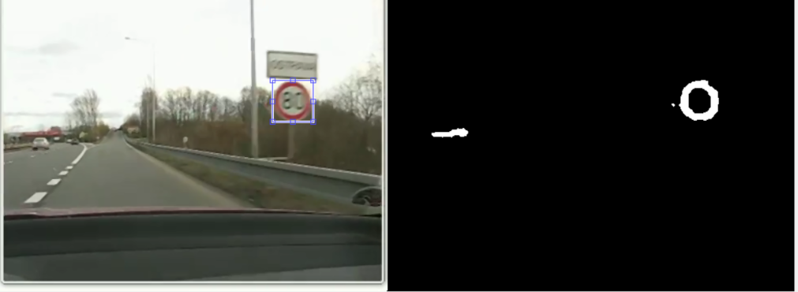
Implementation
We have divided this project into 2 major implementation parts-
Detection phase- during this phase we just detect the presence of traffic sign on road. The blobs present in our frame will be ignored by our algorithm.
Recognition phase-During this phase, we aim to detect the specific traffic sign

Slide 4
Detection phase
This phase can be subdivided into following major phases-
Detecting presence of all possible candidate of traffic sign on road
Template matching our possible candidate with the possible template of a traffic sign
E.g.- triangle shape template,circle shape,double triangle,

Slide 5
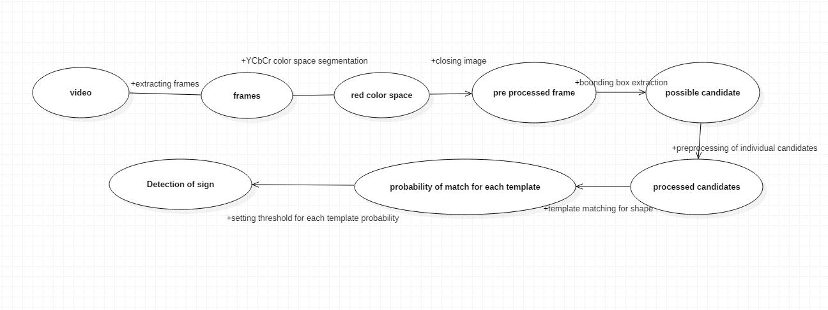
Use case diagram for detection phase

Slide 6
Centroid detection
During the detection phase , the same sign can raise many number of detection prompt.
To curb that ,we introduced centroid detection phase into our detection algorithm.
In this , we find the centroid of our possible candidate according the bounding box size.
As we all know, for all consecutive frame containing the same traffic sign as before, the movement of centroid will be very minute.
We exploited this fact to detect the range of possible positions of the next centroid of same traffic sign.
If the traffic sign lies within that range, we prevent the prompt of detection from occurring.

Slide 7
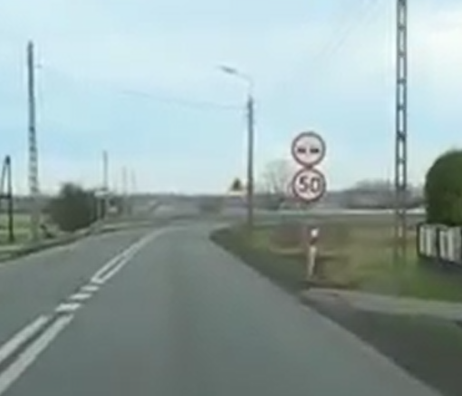
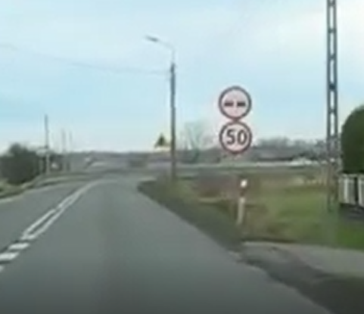
ILLULSTRATION OF HOW CENTROID DETECTION WORK.
This is frame 104. The centroid is (303.72,250.51)
This is frame 106. The centroid is (304.11,248.33)

Slide 8
Recognition phase
In this phase, we have used template matching to match our potential shape candidate of traffic sign with various specific traffic sign matching that shape.
For example narrow road sign ,wide road sign, give way sign all are traffic signs of triangle shape
For this phase ,following phases were done-
Collecting various traffic signs and pre-processing them (which include conversion to grayscale image)
Cropping our potential candidate according to its shape to reduce noise effect and converting it to grayscale.
Matching our potential candidate with various template.
Taking the template with maximum probability as the class of traffic sign.

Slide 9
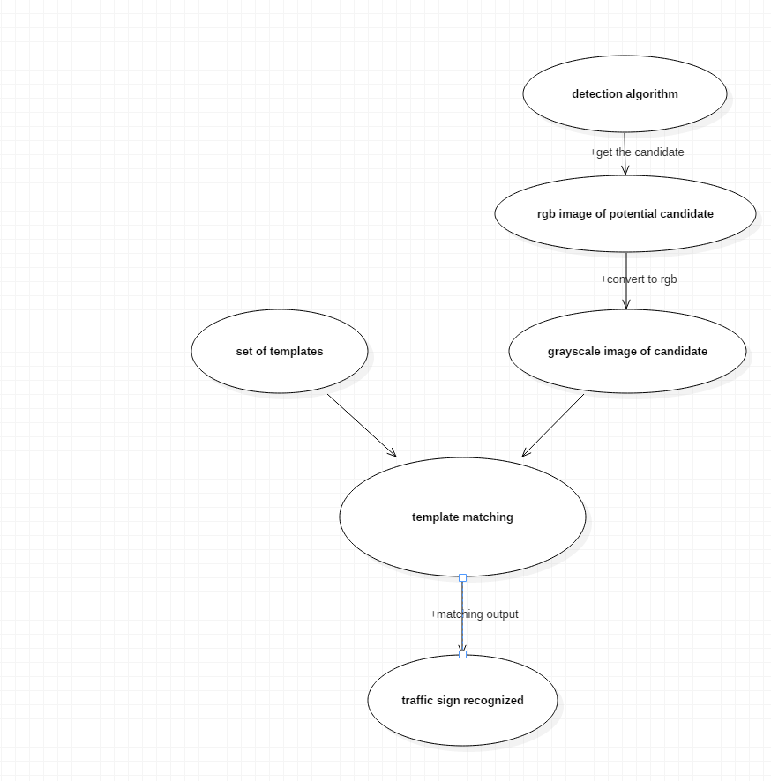
Use case Diagram for recognition model

Slide 10
FUTURE WORKS
Collecting dataset for implementing learning model for recognition phase.
To create a product model of the implementation.

Slide 11
We will now move on to our demo

